Slide 1
CS27 — End of Semester Project
University Management
System Database
DB
GROUP MEMBERS
• CONGO Sougrinoma Anifatou
• NANA Marc
• ZOUNGRANA Zalissa
• YAMEOGO Firmin
• DAKUYO Annette Alexias Prisca
• KANTIONO Diane
Instructor: Kweyakie Afi Blebo

Slide 2
Scenario Overview
System Description: Complete university management system
Objectives:
Manage students, teachers, courses, departments
Track enrollments and grades
Generate academic reports
Users: Administration, teachers, students
Key Features:
Student registration
Course management
Grade recording
Department organization

Slide 3
Part 1 — Database Design
Entity Identification (1.1)
Entity | attributes | Primary key | raison
student | student_id, first_name, last_name, date_of_birth, email, phone_number | student-_id | Unique auto-increment identifier, stable and efficient for relationships
teacher | teacher_id, first_name, last_name, email, phone_number, hire_date | Teacher_id | Same reason - reliable and immutable numeric identifier
course | course_id, course_code, course_name, credits, description | Course_id | Avoids issues if course_code ever changes
department | department_id, department_name, building, office_phone | Department_id | Stable surrogate key to identify each department
enrollment | enrollment_id, student_id, course_id, semester, academic_year, enrollment_date | Enrollment_id | Simplifies junction table management and allows referencing from grade

Slide 4
Part 1 — Database Design
grade | grade_id, enrollment_id, grade_value, grade_date, comments | Grade_id | Each grade is unique and must be identifiable
Design Decision: Used surrogate keys (auto-increment IDs) for stability and performance
Relationships Diagram (1.2 & 1.3)
Relationship | type | description | implementation
department → student | 1:N | One department has many students | FK department_id in student
department → teacher | 1:N | One department employs many teachers | FK department_id in teacher
department → course | 1:N | One department offers many courses | FK department_id in course
teacher → course | 1:N | One teacher can teach many courses | FK teacher_id in course
student ↔ course | M:N | One student takes many courses AND one course has many students | enrollment junction table
student → enrollment | 1:N | One student can have many enrollments | FK student_id in enrollment
course → enrollment | 1:N | One course can have many enrollments | FK course_id in enrollment

Slide 5
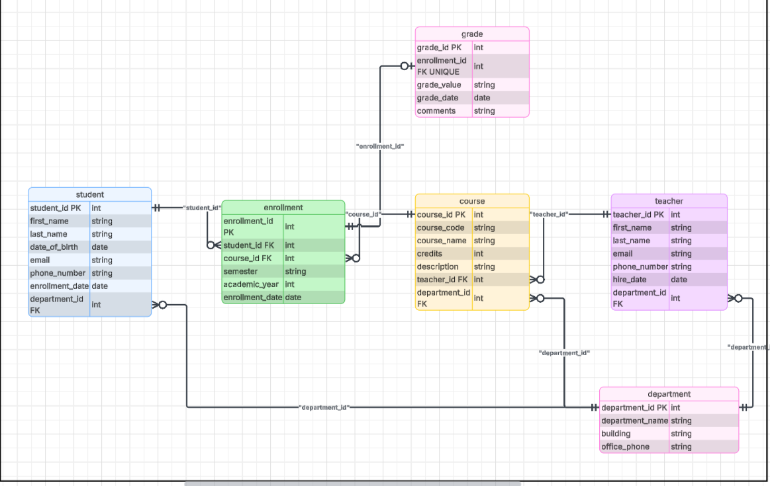
Part 1 — Database Design
enrollment → grade | 1:1 | One enrollment has 0 or 1 final grade | FK enrollment_id (UNIQUE) in grade

Slide 6
Part 1 — Database Design
Normalization Walkthrough (1.4)
Unnormalized Form (Violations)
STUDENT | COURSES | TEACHERS | GRADES
John Doe | Math, Physics | Smith, Jones | 15, 12
Problems:
❌ 1NF: Multi-valued attributes
❌ 2NF: Partial dependencies
❌ 3NF: Transitive dependencies
After 1NF
student | course | teacher | grade
John Doe | Math | Smith | 15
John Doe | Physics | Jones | 12
Final 3NF Schema
6 tables with no redundancy, full functional dependencies

Slide 7
Part 2— MySQL Implementation
Database Implementation (2.1)
Data Types & Constraints:
sql
-- Example: Student table
CREATE TABLE student (
student_id INT AUTO_INCREMENT PRIMARY KEY,
first_name VARCHAR(50) NOT NULL,
last_name VARCHAR(50) NOT NULL,
email VARCHAR(100) NOT NULL UNIQUE,
enrollment_date DATE NOT NULL DEFAULT (CURRENT_DATE),
department_id INT,
FOREIGN KEY (department_id) REFERENCES department(department_id)
);
Key Constraints Used:
PRIMARY KEY - Unique identification
FOREIGN KEY - Referential integrity
NOT NULL - Required fields
UNIQUE - Prevent duplicates (email)
CHECK - Validate grade range (0-20)
DEFAULT - Auto-set enrollment date

Slide 8
Part 2— MySQL Implementation
Sample Data (2.2)
Database Statistics:
4 Departments
10 Teachers
15 Students
12 Courses
30 Enrollments
25 Grades
Sample Student Data:
First_name | Last_name | email | department
John | Kone | john.kone@student.univ.edu | cs
Mary | Traore | mary.traore@student.univ.edu | math
Paul | Ouedraogo | paul.ouedraogo@student.univ.edu | physics

Slide 9
Part 2— MySQL Implementation
UPDATE/DELETE Operations
UPDATE Examples:
sql
-- Update email
UPDATE student SET email = 'new.email@univ.edu' WHERE student_id = 1;
-- Update course credits
UPDATE course SET credits = 5 WHERE course_code = 'CS101';
-- Update grade with comment
UPDATE grade SET grade_value = 15.0, comments = 'Corrected' WHERE grade_id = 5;
DELETE Examples:
sql
-- Delete enrollment (cascades to grade)
DELETE FROM enrollment WHERE student_id = 15 AND course_id = 7;
-- Delete student
DELETE FROM student WHERE student_id = 14;
Referential Integrity:
ON DELETE CASCADE on critical relationships
ON DELETE SET NULL for optional relationships
Violation example: Inserting with invalid FK

Slide 10
Part 2— MySQL Implementation
SELECT Queries (2.4)
Basic Queries:
sql
-- All students
SELECT * FROM student;
-- Students in CS department
SELECT first_name, last_name FROM student WHERE department_id = 1;
-- Top 5 courses by credits
SELECT course_name, credits FROM course ORDER BY credits DESC LIMIT 5;
Filtering:
sql
-- Students with .edu email
SELECT * FROM student WHERE email LIKE '%@univ.edu';
-- Grades between 14 and 18
SELECT * FROM grade WHERE grade_value BETWEEN 14 AND 18;
JOIN Operations:
sql
-- INNER JOIN: Only matching records
-- LEFT JOIN: All courses, even without grades

Slide 11
Part 2— MySQL Implementation
Complex JOIN Example (2.4)
Query: Student performance with teacher information
sql
SELECT
s.first_name AS student,
c.course_name,
t.last_name AS teacher,
g.grade_value
FROM student s
JOIN enrollment e ON s.student_id = e.student_id
JOIN course c ON e.course_id = c.course_id
JOIN teacher t ON c.teacher_id = t.teacher_id
LEFT JOIN grade g ON e.enrollment_id = g.enrollment_id
WHERE g.grade_value IS NOT NULL
ORDER BY g.grade_value DESC;
What this shows:
Connects 5 tables (student → enrollment → course → teacher → grade)
LEFT JOIN ensures we see all enrollments
Filter excludes students without grades
Sorted by performance

